Slide 1
Duncan Floodplain Feasibility Study
Presenters: Andrew Smith, Colin Bitsoie, Sydney Schumacher, Thomas Whelan
Client: Greenlee County Engineer, Phil Ronnerud, PE
Technical Advisor: Tom Loomis, PE
Grading Instructor: Dr. Odem
Smith

Slide 2
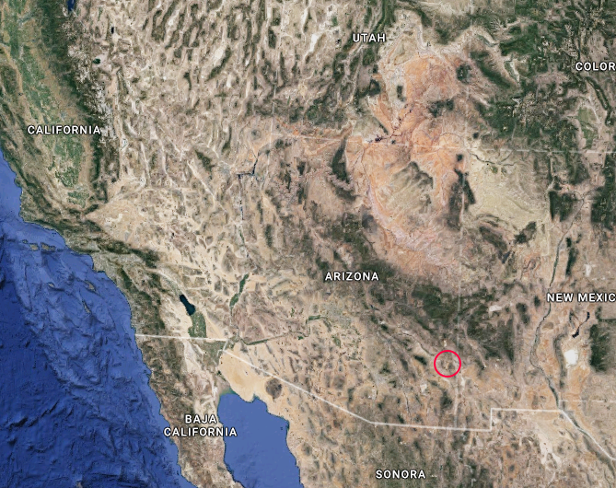
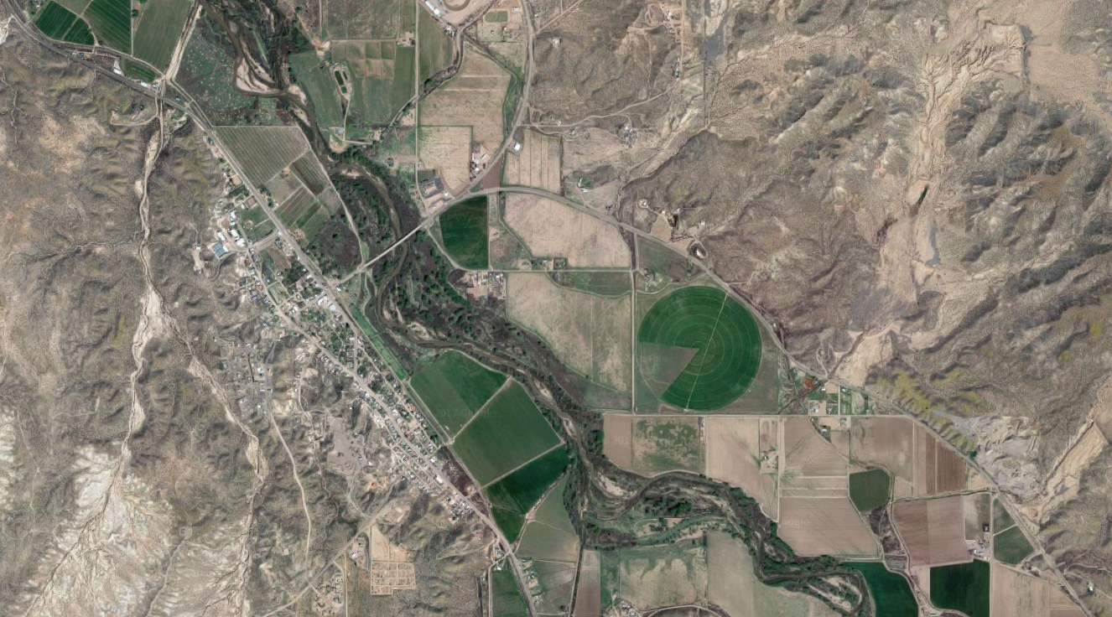
Project Background
Client: Phil Ronnerud, Greenlee County Engineer
Location: Duncan, Arizona
Community:
Ranchers, farmers, and miners
Population: 799 according to 2015 census data
Problem: The Gila River Flooding
Site Location
Figure 1: Project Location [1]
Figure 2: Gila River [1]
Smith

Slide 3
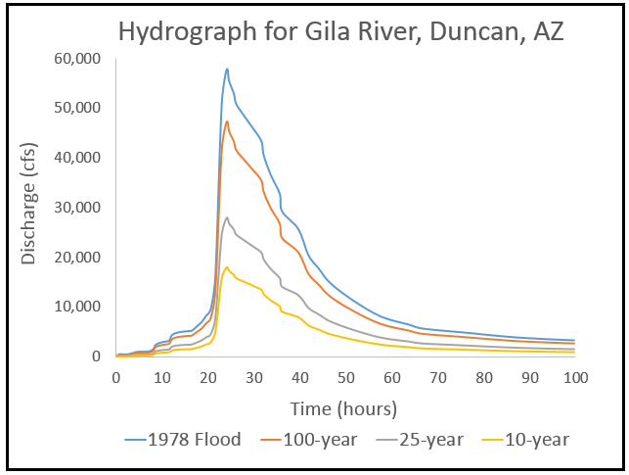
Project Understanding
2015 Capstone Team Findings
1-D Model
2016 Capstone Team Findings
2-D Model
Current Conditions
Site investigation
Figure 3: Gila River Hydrograph [2]
Smith

Slide 4
Challenges/ Stakeholders
Stakeholders:
US Army Corps of Engineers (USACE)
Land Owner's
Federal Emergency Management Agency (FEMA)
Greenlee County Government
Challenges:
Minimal Funding
Cultural and Economic Impacts
Bitsoie

Slide 5
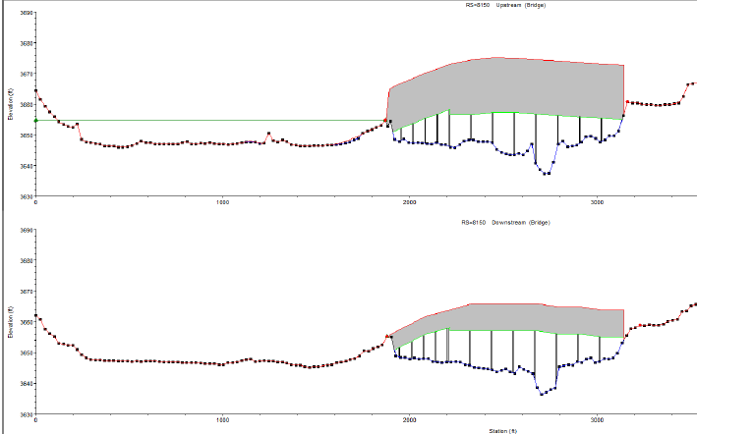
Scope of Services
1. Troubleshoot Data
1.1 HEC-RAS
1.2 Flo 2-D
1.3 Lidar and GIS
Figure 4: Changing Existing Models [3]
Whelan

Slide 6
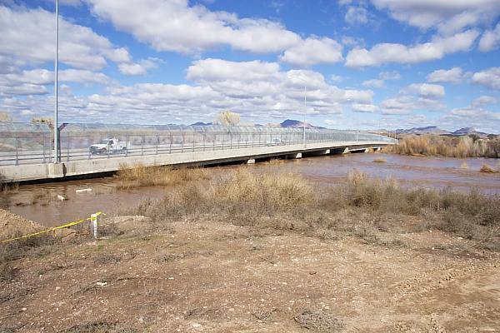
Scope Continued
2.0 Revise Bridge Hydraulics
2.1 HEC-RAS
Widen Piers
Manning's Number
2.2 Flo 2-D
Remove Levee
Remove Bridge Fence
Adjust Storm Data
Figure 5: Duncan Bridge Gate [4]
Schumacher

Slide 7
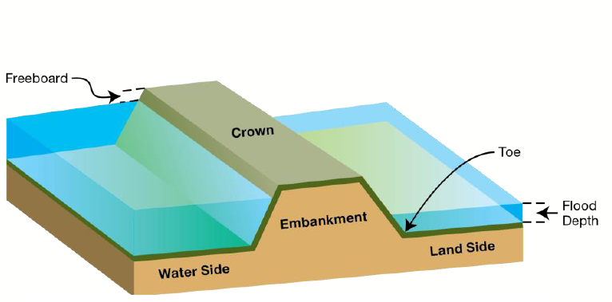
Scope Continued
3.0 Regulation Research
3.1 Meet FEMA, ADOT, and Army Corp Standards
4.0 Results: Technical Report
4.1 Model Results
4.2 Recommended Solutions
4.3 Impacts
Figure 6: Possible Solution: FEMA Levee [5]
Schumacher

Slide 8
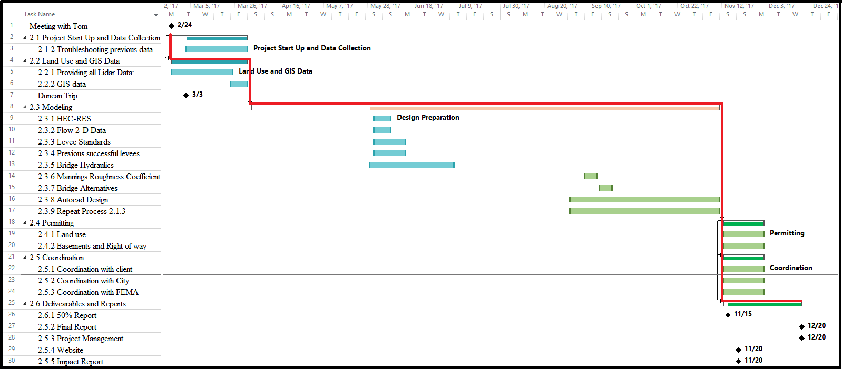
Schedule
Figure 6: Gantt Chart and Critical Path
Whelan
Notes:
Gantt Chart
Critical Path Design
Preparation including modeling/analysis

Slide 9
Staffing & Costs
Table 1: Classification of Positions and Estimate Hours vs Pay Rate.
Classification | Billing rate ($)/hr | Hours (hr) | Total Cost ($)
Senior Engineer | $130 | 189.5 | $24,635
Project Engineer | $ 90 | 301.5 | $27,135
Engineer in Training | $ 75 | 259 | $19,425
Engineering Intern | $ 25 | 184 | $4,600
Total: |  | 934 | $75,795
Bitsoie

Slide 10
References
[1] Project Location. Google Earth. 2017
[2] Hydrograph. Hydro Engineering. 2016
[3] HEC-RAS Model. Hydro Engineering. 2016
[4] R. Shantz , Duncan Bridge. 2005.
[5] “Figure 2: Anatomy of Levees.” FEMA. 2016.
[6] C. Wilson, J. Rapinchuk, A. Alfallaji, and A. Ebrahim, "Floodplain Analysis and Conceptual Levee Alignment along the Gila River," Northern Arizona University, Flagstaff, Dec. 16, 2015.
[7] “Soil Survey of Gila-Duncan, Arizona” Dept. Agriculture, Arizona. 1978.
[8] US Army Corps of Engineers. Levee Safety Program [Online]. Available FTP: http://www.usace.army.mil/Missions/Civil-Works/Levee-Safety-Program/
[9] Federal Emergency Management Agency, DHS [Online]. Available: https://www.fema.
gov/media-library-data/20130726-1541-20490-8375/lv_section6510_0408.pdf
[10] (2007). FloodPartners [Online]. Available: http://www.floodpartners.com/?s=&post_type=
listing&et-listing-type=none&et-listing-location=none&et-listing-rating=none
[11] "USGS Instantaneous Data Archive - IDA", Ida.water.usgs.gov, 2017. [Online]. Available: https://ida.water.usgs.gov/ida/available_records.cfm?sn=09439000.
[12] N. Keegan, “Locally Operated Levees: Issues and Federal Programs” Congressional
Research Service, 2011. Available: https://fas.org/sgp/crs/misc/R41752.pdf.

Slide 11
Questions?

